Slide 1
TECHNICAL AND BUSINESS WRITING SS2007
g
PLEASE JOIN GOOGLE CLASSROOM. CODE-
3yumdc6

Slide 2
About myself.
Hello!
I am SABEEN AMJAD
You can reach me at:
Sabeen.amjad@nu.edu.pk
Office:
Room # 6, faculty offices, e.e. 1st floor

Slide 3
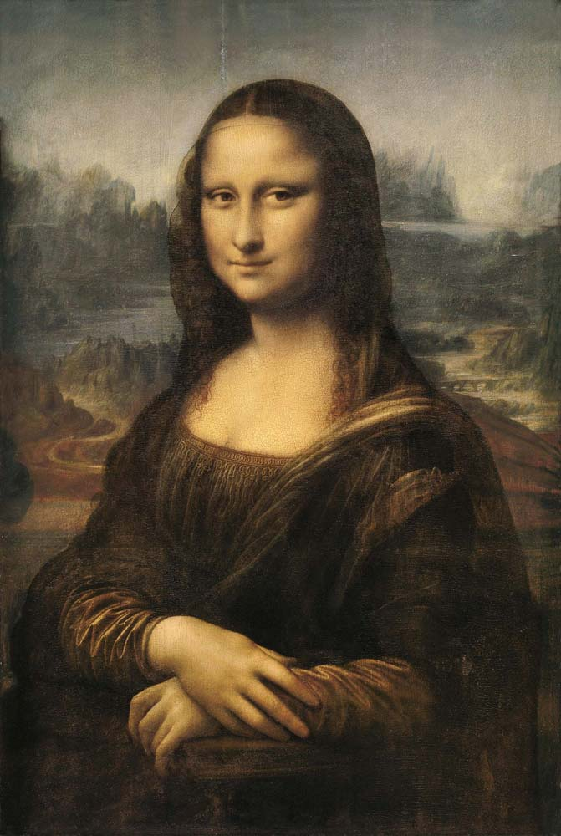

Slide 4
Let’s Compare!
The ever elusive smile, the misty atmosphere, the hazy landscape in the background and, most of all, the ambiguous, inscrutable expression on the face of the sitter entrap the imagination, leaving questions open and fancy disturbed.
Mona Lisa’s exceedingly serene, indifferent disposition further deepens the uncertainty and excites curiosity.
The identity of Leonardo da Vinci's model for his painting Mona Lisa
(Fig. 1) has plagued historians for over 500 years [1]. Early writings stated that mouth and eyes are not distinct [4].
The lower lids are almost horizontal and the absence of eyebrows is striking [7]. The hands appear boneless [6].
Finally, the dress is timeless and quite plain, with no accompanying emblems, jewelry, or accessories [7], unlike that one would have expected had a conventional model been used.

Slide 5

Describe technically

Slide 6
Description 1
TEXT A
One enters the palatial room through an elegantly carved maple door to reveal the French provincial furniture of another century. The plush beige carpet makes one want to run and dance barefoot.

Slide 7
Description 2
TEXT B
The entrance to the 24-ft room is a 36-in. by 80-in. maple door decorated with a carved family crest. The floor has a beige nylon carpet with a 1-in. pad. The furniture is French provincial.

Slide 8
Academic & Technical Writing: a comparison:
Academic Writing | Business & Technical Writing

Slide 9
Academic & Technical Writing: a comparison:
Academic Writing Prose is primary writing mode Thesis is in opening paragraphs Ideas are divided by paragraph Paragraphs are preferred over lists. Sentence diversity is valued. | Business & Technical Writing Lists, bullets, and short paragraphs are primary writing mode Thesis is in paragraph, phrase, or heading Ideas are divided by paragraphs, lists, or sections Lists are preferred over paragraphs. Parallelism and repeated patterns are valued.

Slide 10
Genres of Writing
Fiction Drama Poetry Novel Novelette Novella Short story | Non-Fiction Essays Reports Research thesis Research papers Memos Articles Editorials Reviews Letters

Slide 11
Some more practice!
What genres of writing do you think the following documents
belong to? Choose from the options below.
Essay/poetry/articles/press release/user manuals/novels/research papers/
brochures/news reports/
memos/drama/reviews/feasibility studies/
literature reviews/instructions

Slide 12
Technical Communication
Technical/Professional
Business
Scientific
Subject/field specific experts produce it as it requires expertise (professional qualification/training) in the subject
It aims to run (administer and manage) the business
It aims to report researches and discoveries to advance the field

Slide 13
What is Technical Writing?
“It is a long-established and important professional activity that can be defined as a specialized field of communication whose purpose is to convey technical and scientific information and ideas accurately and efficiently.”
“It can also be defined as the written communication of engineering and scientific ideas, concepts, and data presented objectively, logically, and accurately.”

Slide 14
TW as a Profession
The United States Department of Labor, recognizes technical writer as a distinct job category, stating that technical writers produce Instruction manuals and other supporting documents to communicate complex and technical information more easily. They also develop, gather, and disseminate technical information among customers, designers and manufacturers.
The Society for Technical Communication, the largest professional organization dedicated to advance in the arts and sciences of technical communication, would call a technical writer a technical communicator. Besides, a technical writer can be called as a documentation specialist, information developer, to name just a few

Slide 15
The Importance of Technical Writing:
In most of the cases, these reports and documents are the only form of communication with clients, government agencies, managers, and professionals at other facilities and companies.
The recipient will usually use the report or document to perform a task, make a decision, solve a problem, or acquire information and knowledge.

Slide 16
Common Purposes of Technical Writing:
To inform
To instruct
To persuade

Slide 17
Discuss!
What is the role of a technical communicator?

Slide 18
Discuss!
What is the role of a technical communicator?
Technical communicators translate complex technical
product or service information into understandable and accessible user information.
They act as mediators between product developers and users.

Slide 19
Some rules of thumb for TW
What makes a good writer?
Having something to say
Logical thinking
A few learnable rules of writing style
Read everything (decent and good quality material of course!)
Observe the writer and imitate (his writing talent!)
Superb research skills
Discuss your topic and content (with a trusted someone)
Revise, revise, revise
Edit

Slide 20
Skills Needed to be a Good Technical Writer
Subject Knowledge
Writing Skills
Research Skills
Knowledge of Technical Communication conventions

